Slide 1
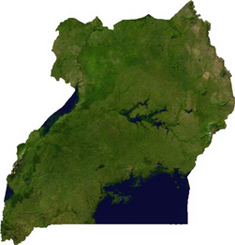

Predicting Droughts in Uganda from meteorological satellite data
Behrouz Eslami & Misha Klein

Slide 2
Satellite data as drought indicators (features)
All features were averaged over each district (i.e. admin. level 1), and either averaged or summed in successive one-month intervals.
Category | Feature | source
Vegetation | EVI NDVI | MOD13A2.006
Precipitation & Evapotranspiration | Precipitation (precipitation per hour v1) hourlyPrecipRate (precipitation per hour v2) Rainf_f_tavg (rainfall) Evap_tavg (evapotranspiration) SPEI (1-12 months) | TRMM 3B43 GSMaP FLDAS FLDAS Rainf_f_tavg & Evap_tavg
Temperature | SoilTemp_tavg (soil temperature 0-10 cm, 10-40 cm, 40-100 cm, 100-200 cm) Tair_f_tavg (air temperature) LST_Day_1km (surface temperature daytime) LST_Night_1km (surface temperature nighttime) | FLDAS FLDAS MOD11A1.006 MOD11A1.006
Soil Moisture | SoilMoi_tavg (soil moisture 0-10 cm, 10-40 cm, 40-100 cm, 100-200 cm) | FLDAS
Other | Wind_f_tavg (wind speed) | FLDAS

Slide 3
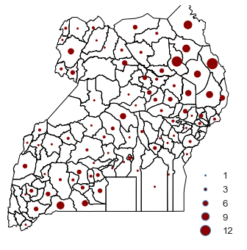
Drought reports (labels)
The drought reports come from two different sources:
the Red Cross desinventar
news articles
Distribution of the drought reports between 2000 and 2019 across Uganda districts.

Slide 4
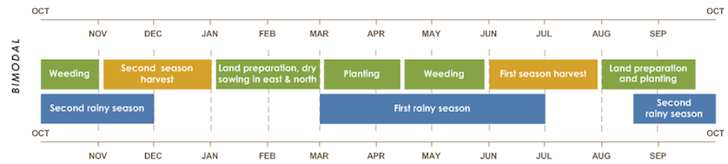
Initial goal: predicting droughts during harvest seasons
We want to predict whether or not a drought occurs in each of the two harvest seasons, based on the features collected in a 3-month period prior the season.
Feature collection
Prediction
Feature collection
Prediction
Feature collection
Bimodal agricultural calendar of Uganda

Slide 5
Data preprocessing
For every feature except SPEI:
For SPEI:
For labels:
Data Filtering:
We average each feature over the three-month period before each harvest season.
We normalize (standardize) each feature per season and district, across all years.
We calculate SPEI with a 3-month time scale, and pick the value that corresponds to the three-month period before each harvest season.
We see whether a drought is reported in the two-month period of each season?
We keep those rows in the dataset that correspond to either a year with a reported drought or a year preceding/following a drought.

Slide 6
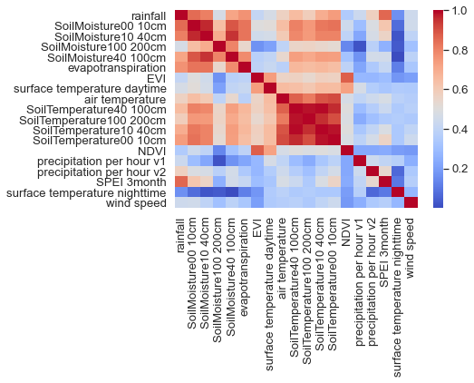
Data Exploration: Correlations between features
The features can be divided into three separated groups.
Correlations matrix for all pairs of features. The colors represent the absolute value of the correlation coefficient.

Slide 7
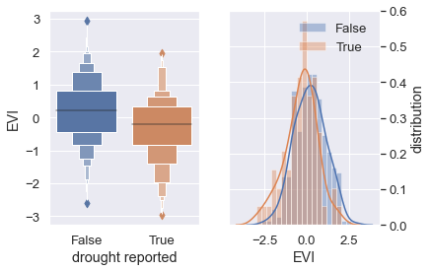
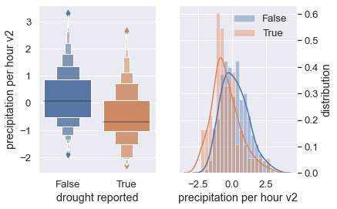
Data Exploration: Correlations between features and the label
Distribution of “precipitation per hour v2” and “EVI separated by the label values.
For more examples please see the report.

Slide 8
Fitting a logistic regression

